Slide 1
“Software Vulnerabilities” Programs and Programming
Basically based on material by Pfleeger & Pfleeger

Slide 2
Some Terminologies
vulnerability
a weakness in a computer system that might be exploited to cause loss or harm
attack
an action that exploits a vulnerability
threat
circumstances that have the potential to cause loss or harm
control - a protective measure
A threat is blocked by control of a vulnerability

Slide 3
Flaws, faults, and failures
A flaw is a problem with a program
A security flaw is a problem that affects security in some way
Confidentiality, integrity, availability (CIA) triad
Flaws come in two types: faults and failures
A fault is a mistake “behind the scenes”
An error in the code, data, specification, process, etc.
A fault is a potential problem

Slide 4
Flaws, faults, and failures
A failure is when something actually goes wrong
failure is a departure from the system’s required behavior.
It can be discovered before or after system delivery, during testing, or during operation and maintenance.
not necessarily from specified behaviour!
A failure is the user/outside view
The quantity and types of faults in requirements design and code implementation are often used as evidence of a product‘s quality or security

Slide 5
Flaws, faults, and failures
A program flaw can be a fault affecting the correctness of the program’s result—that is, a fault can lead to a failure.
Incorrect operation is an integrity failing.
But not every fault corresponds to a failure; for example, if faulty code is never executed or a particular state is never entered, the fault will never cause the code to fail.

Slide 6
Security Failures
Security failures can result from intentional or non-malicious causes; both can cause harm.
Software flaws may be seen and unseen, can be cause for concern in several ways.
Programs are written by humans, and program flaws can range from insignificant to catastrophic.

Slide 7
Security Failures
Despite significant testing, the flaws may appear regularly or sporadically, perhaps depending on many unknown and unanticipated conditions.
Program flaws can have two kinds of security implications:
They can cause integrity problems leading to harmful output or action, and
They offer an opportunity for exploitation by a malicious actor.

Slide 8
Programs Security
Protecting programs is at the heart of computer security
programs constitute any computing system (the operating system, device drivers, the network infrastructure, database management systems and other applications, even executable commands on web pages)
So we need to ask two important questions:
How do we keep programs free from flaws?
How do we protect computing resources against programs that contain flaws?

Slide 9
Secure Programs
What we mean when we say that a program is "secure."
security implies some degree of trust that the program enforces expected confidentiality, integrity, and availability.
From the point of view of a program or a programmer, how can we look at a software component or code fragment and assess its security?
similar to the problem of assessing software quality in general

Slide 10
Secure Programs
One way to assess security or quality is to ask people to name the characteristics of software that contribute to its overall security
different answers from different people because the importance of the characteristics depends on who is analyzing the software
one person may decide that code is secure because it takes too long to break through its security controls
someone else may decide code is secure if it has run for a period of time with no apparent failures
a third person may decide that any potential fault in meeting security requirements makes code insecure

Slide 11
Finding and fixing faults
Once you find some faults, fix them
Usually by making small edits (called patches) to the program
This is called “penetrate and patch”
Patching sometimes makes things worse!
Pressure to patch a fault is often high
Fault may have caused other failures and a partial fix may cause inconsistencies or other problems
The patch for this fault may introduce new faults, here or elsewhere!

Slide 12
Unexpected behaviour
When a program's behaviour is specified, specifications or spec usually lists the things the program must do
Most implementers wouldn't care if it did additional things as well
But from a security / privacy point of view, extra behaviours could be bad!
When implementing a security or privacy relevant program, consider “and nothing else” to be implicitly added to the spec

Slide 13
Types of security flaws: Genesis
Two separate logical categories of program flaws
Inadvertent/unintentional human errors
Intentional
2.1 Malicious flaws are intentionally inserted to attack
If it's meant to attack some particular system, we call it a targeted malicious flaw
2.2 Non-malicious (but intentional) flaws are often features that are meant to be in the system
are correctly implemented,
but can cause a failure when used by an attacker
Most security flaws are caused by unintentional program errors

Slide 14
Fixing Faults
You might argue that a module in which 100 faults were discovered and fixed is better than another in which only 20 faults were discovered and fixed
more rigorous analysis and testing had led to the finding of the larger number of faults.

Slide 15
Fixing Faults
Early work in computer security was based on the paradigm of "penetrate and patch,"
analysts searched for and repaired faults
test a system's security by attempting to cause it to fail
The test was considered to be a "proof" of security
if the system withstood the attacks, it was considered secure
Unfortunately, the proof became a counterexample
The problem discovery in turn led to a rapid effort to "patch" the system to repair or restore the security
However, the patch efforts were largely useless, making the system less secure rather than more secure because they frequently introduced new faults

Slide 16
Unexpected Behavior
A better approach than "penetrate and patch," is to compare the requirements with the behavior
Test whether programs behave as their designers intended or users expected
Unexpected behavior is a program security flaw
Program security flaws can be derived from any kind of software fault
They range from a misunderstanding of program requirements to a one-character error in coding or even typing

Slide 17
Security Flaws
A system attack often exploits an unintentional security flaw to perform intentional damage
Regrettably, we do not have techniques to eliminate or address all program security flaws
security is fundamentally hard and conflicts with usefulness and performance

Slide 18
Security Flaws
Two reasons for this distressing situation
To test a program functionality we test against the “should do” checklist NOT the “should not do” one.
It is almost impossible to ensure that a program does precisely what its designer or user intended, and nothing more.
Programming and software engineering techniques change and evolve far more rapidly than do computer security techniques
So we often find ourselves trying to secure last year's technology while software developers are rapidly adopting today's and next year's technology.

Slide 19
Types of Flaws
Ways in which programs can fail to meet their security requirements
Validation error (incomplete or inconsistent): permission checks
occur when a program fails to check that the parameters supplied or returned to it conform to its assumptions about them, or when these checks are misplaced
Domain error: controlled access to data
occur when the intended boundaries between protection environments are porous including implicit sharing of privileged/confidential data or when then the lower level representation of an abstract object, supposed to be hidden in the current domain, is in fact exposed

Slide 20
Types of Flaws
Most common sources of unintentional security flaws
Buffer overflows (Buffer is intended to hold pre-defined amount of data in memory)
Incomplete mediation
An application needs to ensure that what user has entered constitutes a meaningful request
Verifying that the subject is authorized to perform the operation of an object is called mediation
Incomplete mediation occurs when the application accepts incorrect data from user
Telephone number, date
Validate all input?

Slide 21
Types of Flaws …
Problem due to synchronization
Serialization: program flow order
permit asynchronous behavior of different system components to be exploited (TOCTTOU- time-of-check-to-time-of-use)
TOCTTOU is a class of software bug caused by changes in a system between the checking of a condition (such as a security credential) and the use of the results of that check.
Race Condition
Two processes execute concurrently and the outcome of the computation depends on the order in which instructions of the processes execute

Slide 22
Types of Flaws …
Boundary condition violation: failure on first or last case
occur due to omission of checks to assure that constraints (table size, file allocation, or other resource consumption) are not exceeded
Inadequate identification and authentication: basis for authorization
permits operations to be invoked without sufficiently checking the identity and the authority of the invoking entity

Slide 23
Buffer Overflows
It is an example on Boundary condition violation
Definition
A buffer (or array or string) is a space in which data can be held
A buffer resides in memory
Because memory is finite, a buffer's capacity is finite
in many programming languages the programmer must declare the buffer's maximum size
Then the compiler can set aside that amount of space

Slide 24
Buffer Overflows
Example
char sample[10];
One byte for elements sample[0] through sample[9]
Now we execute the statement:
sample[10] = 'B';
The subscript 10 is out of bounds
The compiler can detect it during the compilation
However, if the statement were
sample[i] = 'B';
we could not identify the problem until i was set during execution
The problem's occurrence depends on what is adjacent to the array sample

Slide 25
Buffer overflows
The single most commonly exploited type of security flaw
Simple example:
#define LINELEN 1024
char buffer[LINELEN];
gets(buffer);
or
strcpy(buffer, argv[1]);

Slide 26
Buffer overflows problem?
The gets and strcpy functions don't check that the string they're copying into the buffer will fit in the buffer!
Some languages would give an exception here, and crash the program.
Is this an OK solution
C doesn't even notice something bad happened

Slide 27
Buffer overflows problem?
Buffer overflow is an event that occurs when:
Fixed-length data buffer (e.g., string)
At least one value intended for buffer is written outside that buffer's boundaries (usually past its end)
Some definitions also include reading outside buffer
Can occur when reading input or later processing data

Slide 28
Buffer overflows problem?
Buffer overflows = buffer overruns.
Subtypes include:
Stack overrun. Buffer in stack; attack is called “stack smashing”
Heap overrun. Buffer in heap; attack is called “heap smashing”
Noted in “Computer Security Technology Planning Study” (1972)
Common problem
If exploitable
Attacker can often completely control program
Attacker can typically cause denial-of-service
Many defenses simply downgrade from “control program” to DoS

Slide 29
Buffer overflow example incidents
1988: Morris worm – took down Internet
Includes buffer overflow via gets() in fingerd
1998: University of Washington IMAP (mail) server
1999: RSA crypto reference implementation
Subverted PGP, OpenSSH, Apache’s ModSSL, etc.
2001: Code Red worm – buffer overflow in Microsoft’s Internet Information Services (IIS) 5.0
2003: SQL Slammer worm compromised machines running Microsoft SQL Server 2000
~2008: Twilight hack

Slide 30
Programming languages & buffer overflow
Some languages allow buffer overflow
C, C++, Objective-C, Vala, Forth, assembly language
First three are especially common
Most languages counter buffer overflow…
Ada strings, Pascal: Detect/prevent overflow
Java, Python, Perl, Ada unbounded_string: Auto-resize
Using other languages doesn’t give immunity
Most language implementations are in C/C++
Many libraries/components/OSs include C/C++
Some languages/compilers allow disabling protection
Including languages C# and Ada
Choosing another language helps – but not completely

Slide 31
Nonmalicious Program Errors
Unintentional mistakes
cause program malfunctions
but some lead to more serious security vulnerabilities
Buffer Overflows Security Implication
Attacker replaces code in the system space and takes control back from the operating system
Attacker uses the stack pointer or return register to execute other code

Slide 32
Famous Internet Worms
Morris worm (1988): overflow in fingerd
6,000 machines infected (10% of existing Internet)
CodeRed (2001): overflow in MS-IIS server
300,000 machines infected in 14 hours
SQL Slammer (2003): overflow in MS-SQL server
75,000 machines infected in 10 minutes (!!)
Sasser (2004): overflow in Windows LSASS
Around 500,000 machines infected
Responsible for user
authentication in Windows

Slide 33
… Malware …
Conficker (2008-09): overflow in Windows RPC
Around 10 million machines infected (estimates vary)
Stuxnet (2009-10): several zero-day overflows + same Windows RPC overflow as Conficker
Windows print spooler service
Windows LNK shortcut display
Windows task scheduler
Destroyed several Iranian Nuclear Centrifuges (Siemens' PLCs)
Flame (2010-12): same print spooler and LNK overflows as Stuxnet
Targeted Cyberespionage virus

Slide 34
Memory Exploits
Simplest buffer exploit: supply executable code as “data”, trick victim’s machine into executing it
Code will self-propagate or give attacker control over machine
Attack can exploit any memory operation and need not involve code injection or data execution
Pointer assignment, format strings, memory allocation and de-allocation, function pointers, calls to library routines via offset tables …

Slide 35
Buffer Overflows
Example
Suppose each of the ten elements of the array sample is filled with the letter A and the erroneous reference uses the letter B, as follows:
for (i=0; i<=9; i++)
sample[i] = 'A';
sample[10] = ’B’;

Slide 36
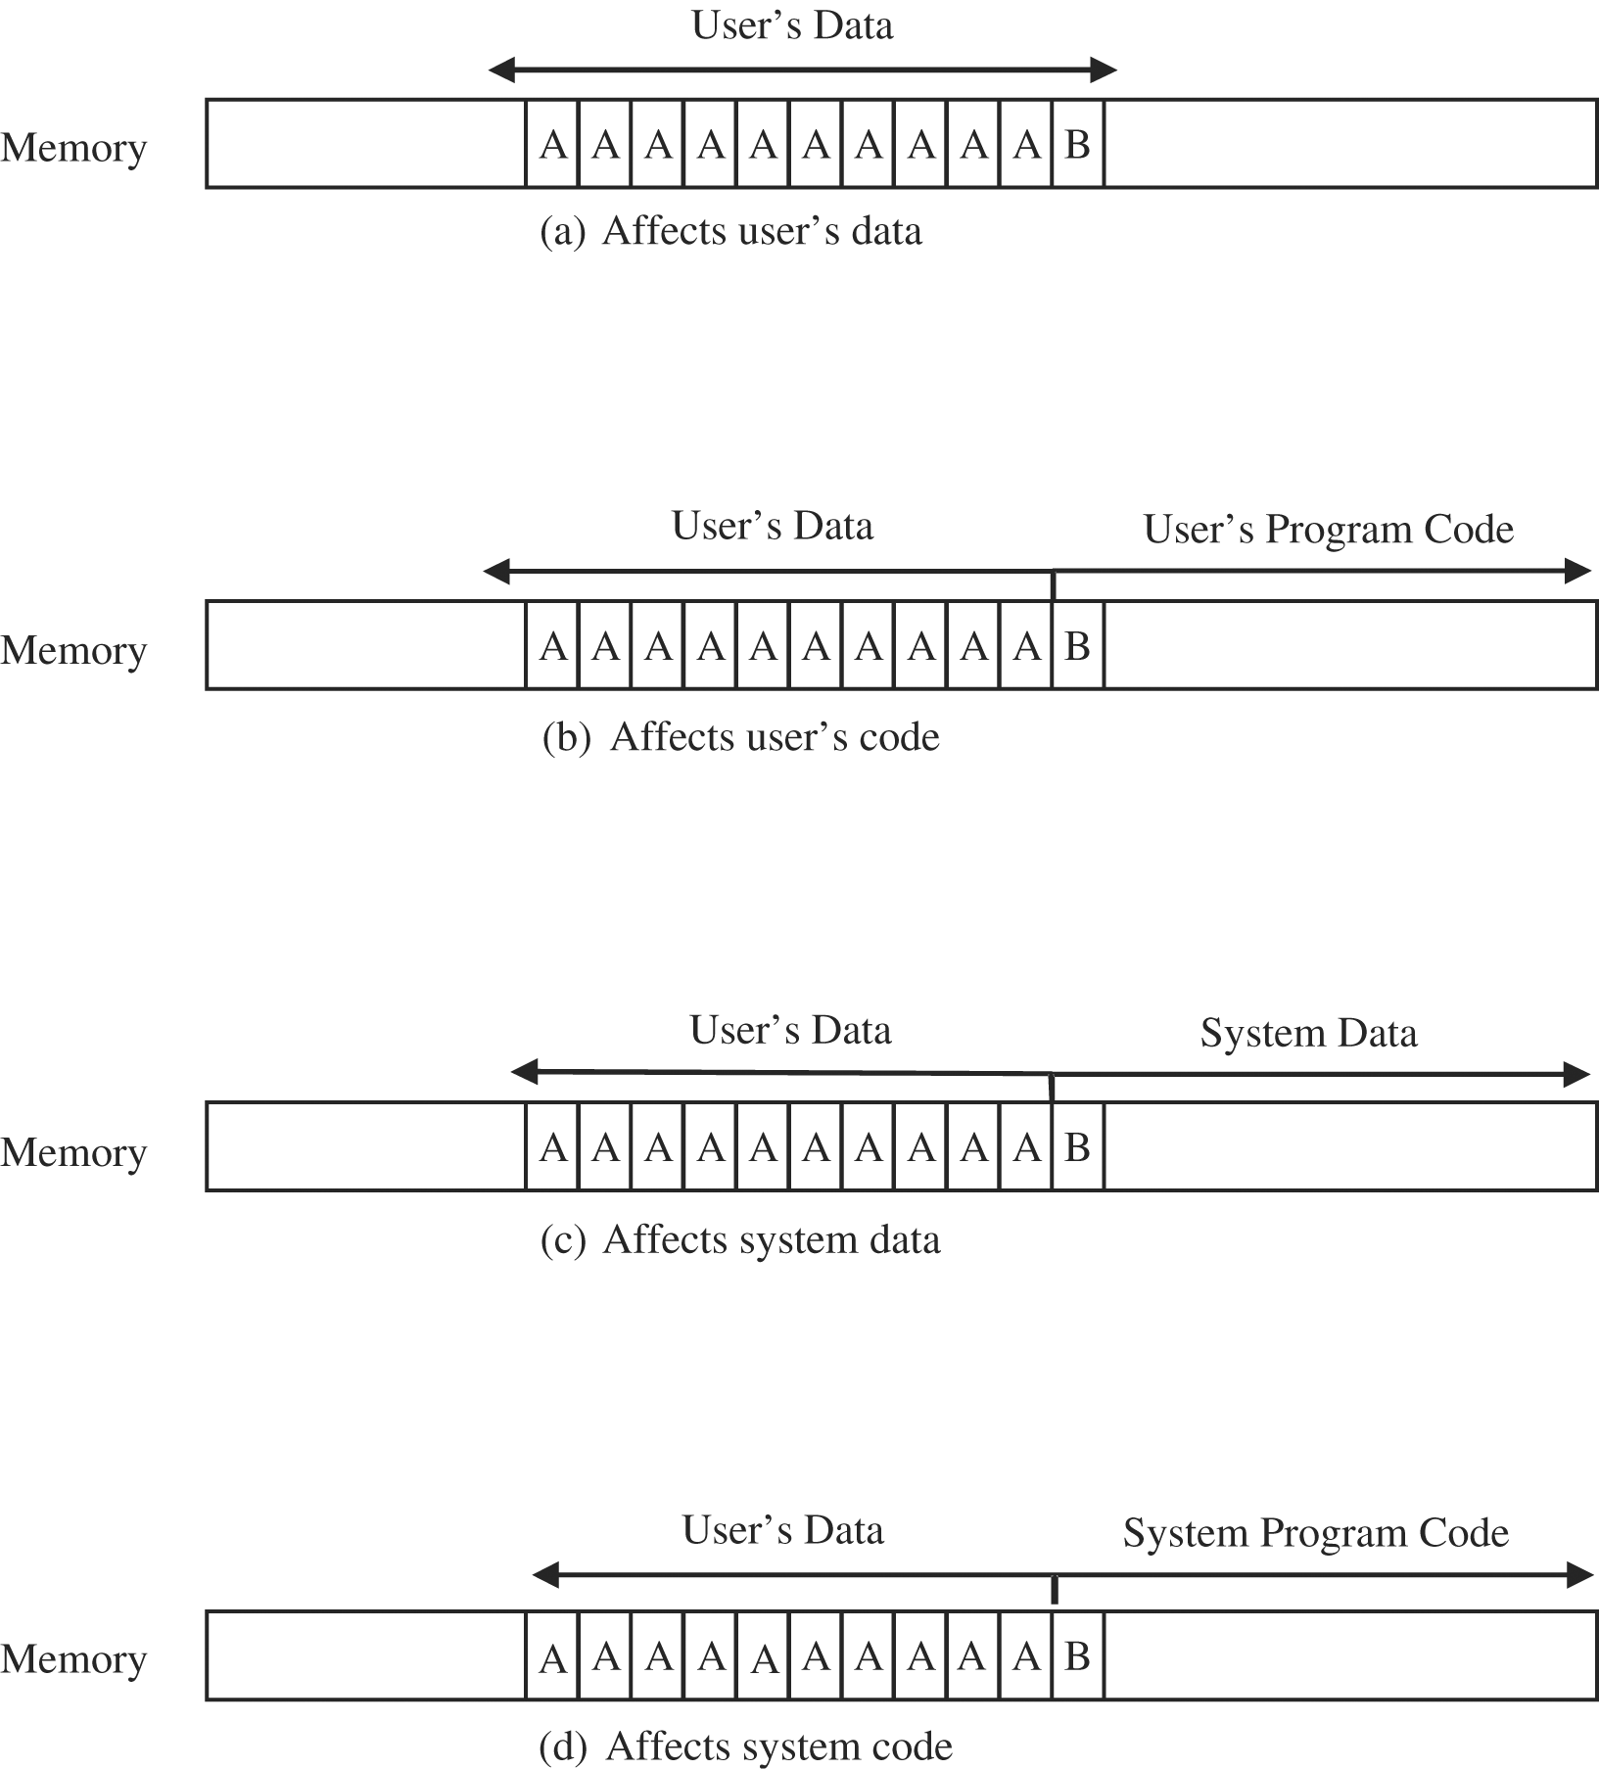
Buffer Overflows (Example Cont.)
There are four cases to
consider in deciding where
the 'B' goes

Slide 37
Buffer Overflows (Example Cont.)
If the extra character overflows into the user's data space
it simply overwrites an existing variable value
perhaps affecting the program's result
but affecting no other program or data
In the second case, the 'B' goes into the user's program area
If it overlays an already executed instruction
no effect
If it overlays an instruction that is not yet executed
the machine will try to execute an instruction with operation code 0x42
the internal code for the character 'B‘
Spilling over into system data or code areas produces similar results to those for the user's space: computing with a faulty value or trying to execute an improper operation.

Slide 38
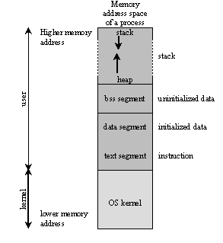
Process Address Space

Slide 39
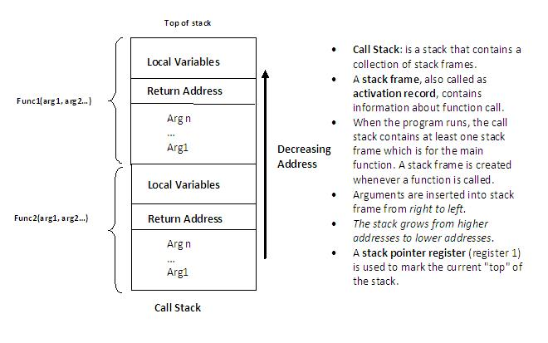
Call Stack / Activation Record

Slide 40
Stack Buffers
Suppose a Web server contains function
void func(char *str) {
char buf[126];
strcpy(buf,str);
}
When this function is invoked, a new frame (activation record) is pushed onto the stack
Allocate local buffer
(126 bytes reserved on stack)
Copy argument into local buffer
Stack grows this way
buf
sfp
ret
addr
str
Frame of the
calling function
Top of
stack
Local variables
Pointer to
previous
frame
Arguments
Execute code
at this address
after func() finishes

Slide 41
What If Buffer Is Overstuffed?
Memory pointed to by str is copied onto stack…
void func(char *str) {
char buf[126];
strcpy(buf,str);
}
If a string longer than 126 bytes is copied into buffer, it will overwrite adjacent stack locations
strcpy does NOT check whether the string
at *str contains fewer than 126 characters
buf
overflow
str
Frame of the
calling function
Top of
stack
This will be interpreted
as return address!

Slide 42
Executing Attack Code
Suppose buffer contains attacker-created string
For example, str points to a string received from the network as the URL
When function exits, code in the buffer will be
executed, giving attacker a shell
Root shell if the victim program is setuid root
code
ret
str
Top of
stack
Frame of the
calling function
Attacker puts actual assembly
instructions into his input string, e.g.,
binary code of execve(“/bin/sh”)
In the overflow, a pointer back into the buffer
appears in the location where the program
expects to find return address

Slide 43
Notional process memory map
Lower-numbered
addresses
Text (compiled program code)
Often
read-
only
Initialized
global “data”
Set on
code
load
This diagram shows
how stacks grow on
Intel x86s & others;
some grow other way.
Multi-threaded programs
have multiple stacks
Used
for global
constants
& variables
Uninitialized
global “data”
Heap grows, e.g.,
due to “new” or malloc()
Heap
(dynamically allocated)
Heap pointer
Stack (procedure/ method calls)
Stack pointer (SP)
(current top of stack)
Higher-numbered
addresses
Stack grows, e.g.,
due to procedure call

Slide 44
“Stack” in a process memory map
Memory area set aside to implement calls to a function/method
Stack is used to implement control flow
When you call a procedure, where it “came from” is pushed on stack
When a procedure returns, the “where I came from” is popped from stack; system starts running code there
Stack also used for other data (in many cases)
Parameters passed to procedures
Procedure local variables
Return values from procedure

Slide 45
Why use stacks for procedure calls?
First compiled languages (e.g., FORTRAN) did not use stacks
Stored, with procedure, where program “came from”
Result: Procedures could not call themselves, directly or indirectly, as that would overwrite stored info
Extremely limiting, easy to get wrong
If procedures can arbitrarily call other procedures
Need to store old state so can return back
Need dynamic allocation for call (frame) sequences
Stack is flexible & efficient

Slide 46
Calling a procedure
Given this C program:
void main() {
f(1,2,3);
}
The invocation of f() might generate assembly:
pushl $3 ; constant 3
pushl $2 ; Most C compilers push in reverse order by default
pushl $1
call f
“call” instruction pushes instruction pointer (IP) on stack
In this case, the position in “main()” just after f(…)
Saved IP named the return address (RET)
CPU then jumps to start of “function”

Slide 47
Stack: Overflowing buffer2
Lower-numbered
addresses
Stack pointer (SP)
(current top of stack)
Local array “buffer2”
Local array “buffer1”
Overwrite
Frame pointer (FP) –
use this to access
local variables &
parameters
Saved (old) frame pointer
Return address in main()
1
2
Higher-numbered
addresses
3
Stack grows, e.g.,
due to procedure call

Slide 48
What happens if we write past the end of buffer2?
Overwrites whatever is past buffer2!
As you go further, overwrite higher addresses
Impact depends on system details
In our example, can overwrite:
Local values (buffer1)
Saved frame pointer
Return value (changing what we return to)
Parameters to function
Previous frames

Slide 49
Common buffer overflow attack
Send data that is too large, or will create overlarge data
Overlarge data overwrites buffer
Modifies return value, to point to something the attacker wants us to run
Maybe with different parameters, too
On return, runs attacker-selected code
But it gets worse…

Slide 50
Inserting code in the buffer overflow attack (e.g., shell code)
Attacker can also include machine code that they want us to run
If they can set the “return” value to point to this malicious code, on return the victim will run that code
Unless something else is done
“Smashing the Stack”

Slide 51
Stack: One possible result after attack
Lower-numbered
addresses
Stack pointer (SP)
(current top of stack)
Local array “buffer2”
Malicious code
Local array “buffer1”
Frame pointer (FP) –
use this to access
local variables &
parameters
Saved (old) frame pointer
Return address in main()
Ptr to malicious code
1
2
Higher-numbered
addresses
3
Stack grows, e.g.,
due to procedure call

Slide 52
Stack: One possible result after attack
Lower-numbered
addresses
Stack pointer (SP)
(current top of stack)
Local array “buffer2”
NOP sleds let attacker jump anywhere to attack; real ones often more complex (to evade detection)
NOP sled: \x90\x90\x90\x90\x90….
Shellcode: \xeb\x1f\x5e\x89\x76\x08\x31\xc0\x88\x46\x07\x89\x46\x0c\xb0\x0b\x89\xf3\x8d\x4e\x08\x8d\x56\x0c\xcd\x80\x31\xdb\x89\xd8\x40\xcd\x80\xe8\xdc\xff\xff\xff/bin/sh
Local array “buffer1”
Frame pointer (FP) –
use this to access
local variables &
parameters
Shellcode often has odd constraints, e.g., no byte 0
Saved (old) frame pointer
Return address in main()
Ptr to malicious code
1
2
Higher-numbered
addresses
3
Stack grows, e.g.,
due to procedure call

Slide 53
Stack Corruption: General View
int bar (int val1) {
int val2;
foo (a_function_pointer);
}
val1
val2
arguments (funcp)
return address
Saved Frame Pointer
pointer var (ptr)
buffer (buf)
String grows
Attacker-controlled memory
int foo (void (*funcp)()) {
char* ptr = point_to_an_array;
char buf[128];
gets (buf);
strncpy(ptr, buf, 8);
(*funcp)();
}
Most popular target
Stack grows

Slide 54
Attack #1: Return Address
args (funcp)
return address
PFP
pointer var (ptr)
buffer (buf)
② set stack pointers to return to a dangerous library function
Attack code
“/bin/sh”
①
system()
Change the return address to point to the attack code. After the function returns, control is transferred to the attack code.
… or return-to-libc: use existing instructions in the code segment such as system(), exec(), etc. as the attack code.

Slide 55
Other types of attacks possible with a stack buffer overflow
Make “return” point to existing code that the attacker wants us to run now
E.G., invoke a shell, debug code
Perhaps modify parameters
Change value of adjacent local variables
Change value of parameters
... and so on

Slide 56
Function Pointer Overflow
C uses function pointers for callbacks: if pointer to F is stored in memory location P, then another function G can call F as (*P)(…)
Buffer with attacker-supplied
input string
Callback
pointer
attack code
overflow
Legitimate function F
(elsewhere in memory)

Slide 57
Attack #2: Pointer Variables
args (funcp)
return address
SFP
pointer var (ptr)
buffer (buf)
Attack code
Global Offset Table
Syscall pointer
Change a function pointer to point to attack code
Any memory, on or off the stack, can be modified by a statement that stores a value into the compromised pointer
strcpy(buf, str);
*ptr = buf[0];

Slide 58
Off-By-One Overflow
void notSoSafeCopy(char *input) {
char buffer[512]; int i;
for (i=0; i<=512; i++)
buffer[i] = input[i];
}
void main(int argc, char *argv[]) {
if (argc==2)
notSoSafeCopy(argv[1]);
}
This will copy 513
characters into the
buffer.
1-byte overflow: can’t change RET, but can change saved pointer to previous stack frame
Caller’s RET will be read from buffer!

Slide 59
Attack #3: Frame Pointer
args (funcp)
return address
SFP
pointer var (ptr)
buffer (buf)
Fake return address
Fake SFP
Attack code
Arranged like a
real frame
Change the caller’s saved frame
pointer to point to attacker-controlled
memory. Caller’s return address will be
read from this memory.

Slide 60
Buffer Overflow: Causes and Cures
“Classic” memory exploit involves code injection
Put malicious code at a predictable location in memory, usually masquerading as data
Trick vulnerable program into passing control to it
Overwrite saved EIP, function callback pointer, etc.
Idea: prevent execution of untrusted code
Make stack and other data areas non-executable
Digitally sign all code
Ensure that all control transfers are into a trusted, approved code image

Slide 61
Smashing elsewhere
“Heap” contains dynamically-allocated data
“new” (Java/C++), malloc (C), etc.
“Data” contains global data
Including key infrastructure control values
If attacker can overwrite beyond buffer, can control other values (e.g., stored afterwards)
Values of other structures
Heap: Heap maintenance data (e.g., what’s free/used)
Even 1 character overwrite can be devastating
Details are system-dependent
But attackers can typically exploit them too
Basic issue same as smashing the stack

Slide 62
An Example
referent object (4 bytes)
{
char *p, *q, *r, *s;
p = malloc(4);
q = p+1;
s = p+5;
r = s-3;
}
s is set to ILLEGAL
out of bounds!
Program will crash if
r is ever dereferenced
Note: this code works even though
it’s technically illegal in standard C

Slide 63
Integer Overflow
Since an integer is a fixed size (e.g. 32 bits for 4-byte long), there is a fixed maximum value it can store. When an attempt is made to store a value greater than this maximum value it is known as an integer overflow.
Most compilers seem to ignore the overflow, resulting in an unexpected or erroneous result being stored.
This can get dangerous if the calculation has to do with the size of a buffer or how far into an array to index.
What happens then!!
a = 0xffffffff
b = 0x1
r = a + b ➔ r = (0xffffffff + 0x1) % 0x100000000
r = (0x100000000) % 0x100000000 = 0
This is often called a "wrap around", as the result appears to wrap around to 0.

Slide 64
Integer Overflow Examples
Example 1
#include <stdio.h>
int main(void){
unsigned int num = 0xffffffff;
printf("num + 1 = 0x%x\n", num + 1);
return 0;
}
/* EOF */
The output of this program looks like this:
num + 1 = 0x0
Example 2
#include <stdio.h>
int main(void){
int l;
l = 0x7fffffff;
printf("l + 1 = %d (0x%x)\n", l + 1 , l + 1);
return 0;
}
/* EOF */
The output of which is:
l = 2147483647 (0x7fffffff)
l + 1 = -2147483648 (0x80000000)

Slide 65
Range Checking!!
strcpy does not check input size
strcpy(buf, str) simply copies memory contents into buf starting from *str until “\0” is encountered, ignoring the size of area allocated to buf
Many C library functions are unsafe
strcpy(char *dest, const char *src)
strcat(char *dest, const char *src)
gets(char *s)
scanf(const char *format, …)
printf(const char *format, …)

Slide 66
Two code solution alternatives: Bounds-checking & auto-resize
Bounds-checking to stop overwrite; then if oversized:
Stop processing input
Reject and try again, or even halt program (turns into DoS)
Truncate data. Common approach, but has issues:
Terminates text “in the middle” at place of attacker’s choosing
Can strip off critical data, escapes, etc. at the end
Way better to truncate than to allow easy buffer overflow attack
Auto-resize (many languages)
Must deal with “too large” data
C: Requires more code changes/complexity in existing code
C/C++: Dynamic allocation (double-free)

Slide 67
From unsigned | To | Method
char | char | Preserve bit pattern; high-order bit becomes sign bit
char | short | Zero-extend
char | long | Zero-extend
char | unsigned short | Zero-extend
char | unsigned long | Zero-extend
short | char | Preserve low-order byte
short | short | Preserve bit pattern; high-order bit becomes sign bit
short | long | Zero-extend
short | unsigned char | Preserve low-order byte
long | char | Preserve low-order byte
long | short | Preserve low-order word
long | long | Preserve bit pattern; high-order bit becomes sign bit
long | unsigned char | Preserve low-order byte
long | unsigned short | Preserve low-order word
Key:
Lost data
Misinterpreted data

Slide 68
From | To | Method
char | short | Sign-extend
char | long | Sign-extend
char | unsigned char | Preserve pattern; high-order bit loses function as sign bit
char | unsigned short | Sign-extend to short; convert short to unsigned short
char | unsigned long | Sign-extend to long; convert long to unsigned long
short | char | Preserve low-order byte
short | long | Sign-extend
short | unsigned char | Preserve low-order byte
short | unsigned short | Preserve bit pattern; high-order bit loses function as sign bit
short | unsigned long | Sign-extend to long; convert long to unsigned long
long | char | Preserve low-order byte
long | short | Preserve low-order word
long | unsigned char | Preserve low-order byte
long | unsigned short | Preserve low-order word
long | unsigned long | Preserve pattern; high-order bit loses function as sign bit
Key:
Lost data
Misinterpreted data

Slide 69
Signed Integer Conversion Example
1. unsigned int l = ULONG_MAX;
2. char c = -1;
3. if (c == l) {
4. printf("-1 = 4,294,967,295?\n");
5. }
The value of c is compared to the value of l.
Because of integer promotions, c is converted to an unsigned integer with a value of 0xFFFFFFFF or 4,294,967,295

Slide 70
Overflow Example 1
1. int i;
2. unsigned int j;
3. i = INT_MAX; // 2,147,483,647
4. i++;
5. printf("i = %d\n", i);
6. j = UINT_MAX; // 4,294,967,295;
7. j++;
8. printf("j = %u\n", j);
i=-2,147,483,648
j = 0

Slide 71
Overflow Example
9. i = INT_MIN; // -2,147,483,648;
10. i--;
11. printf("i = %d\n", i);
12. j = 0;
13. j--;
14. printf("j = %u\n", j);
i=2,147,483,647
j = 4,294,967,295

Slide 72
Truncation Error Example
1. char cresult, c1, c2, c3;
2. c1 = 100;
3. c2 = 90;
4. cresult = c1 + c2;
Adding c1 and c2 exceeds the max size of signed char (+127)
Truncation occurs when the value is assigned to a type that is too small to represent the resulting value
Integers smaller than int are unlikely to overflow because the actual operations are performed on the promoted values.
Integers smaller than int are promoted to int or unsigned int before being operated on

Slide 73
Sign Error Example
Implicit conversion to smaller unsigned integer
int i = -3;
unsigned short u;
u = i;
printf("u = %hu\n", u);
There are sufficient bits to represent the value so no truncation occurs. The two’s complement representation is interpreted as a large signed value, however, so u = 65533

Slide 74
Integer Overflow Example
void getComment(unsigned int len, char *src) {
unsigned int size;
size = len - 2;
char *comment = (char *)malloc(size + 1);
memcpy(comment, src, size);
return;
}
int _tmain(int argc, _TCHAR* argv[]) {
getComment(1, "Comment ");
return 0;
}
0 byte malloc() succeeds
Size is interpreted as a large positive value of 0xffffffff
Possible to cause an overflow by creating
an image with a comment length field of 1

Slide 75
Sign Error Example 1
Program accepts two arguments (the length of data to copy and the actual data)
#define BUFF_SIZE 10
int main(int argc, char* argv[]){
int len;
char buf[BUFF_SIZE];
len = atoi(argv[1]);
if (len < BUFF_SIZE){
memcpy(buf, argv[2], len);
}
}

Slide 76
Overflow Countermeasures
Staying within bounds
Check lengths before writing
Confirm that array subscripts are within limits
Double-check boundary condition code for off-by-one errors
Limit input to the number of acceptable characters
Limit programs’ privileges to reduce potential harm
Many languages have overflow protections
Code analyzers can identify many overflow vulnerabilities
Canary values in stack to signal modification

